Slide 1
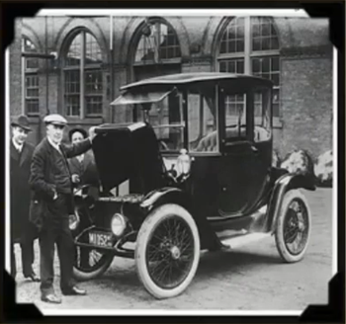
Electric Vehicle (EV)
• EVs date back to 1834 and the credit goes to a Vermont blacksmith, Thomas Davenport who constructed first non-rechargeable DC motor based electric car
• However, EVs got disappeared in 1920s and ICEV gained the momentum and captured the market
But, EVs as a means of cleaner mobility drawn attention of authorities to curb climate change

Slide 2
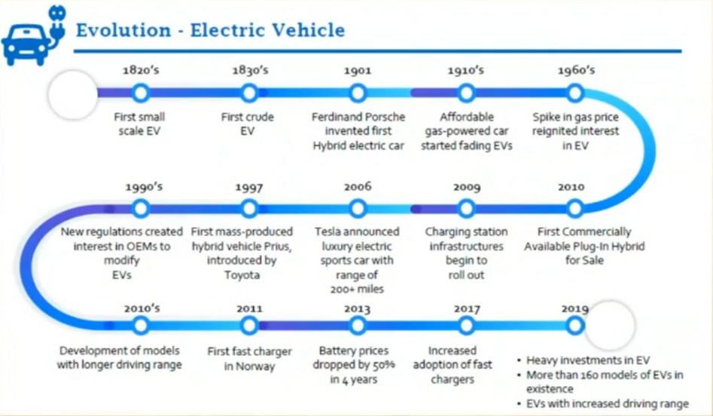
History of electric vehicles

Slide 3
Choosing right electric vehicle
Plug-in
Hybrid EV
BEV
EV
Plug-in
EV
EREV
PHEV
Hybrid
Electric
Vehicle
Battery
HEV
PEV
Extended
Range EV

Slide 4
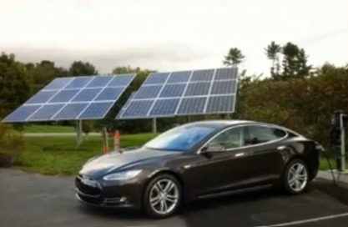
Battery electric vehicle
The BEV is propelled by an electric motor only ;
One energy source only is taken on-boards i.e. battery.
Advantages
Zero Emission Vehicle ZEV.
Single torque source (electric motor) to the driven
wheels simple speed control.
Nearly ideal torque-speed characteristic multigear transmission unnecessary.
Simple structure and control of the traction system.
Can use renewable sources for charging.

Slide 5
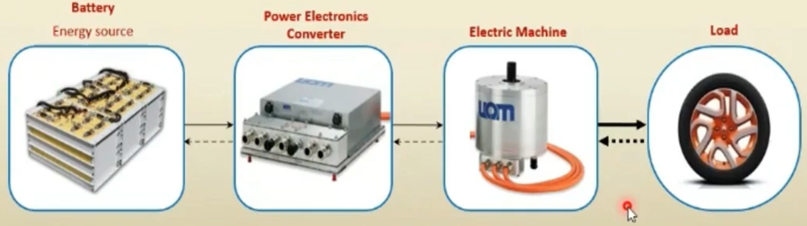
Disadvantages
Limitation of driving range and speed.
It is mainly a city car.
Components and Energy Flow of BEV Traction System
The electric machine (Motor) delivers mechanical power to load;
The electric machine (Generator) obtains mechanical power from load
batteries (Regenerative braking).

Slide 6
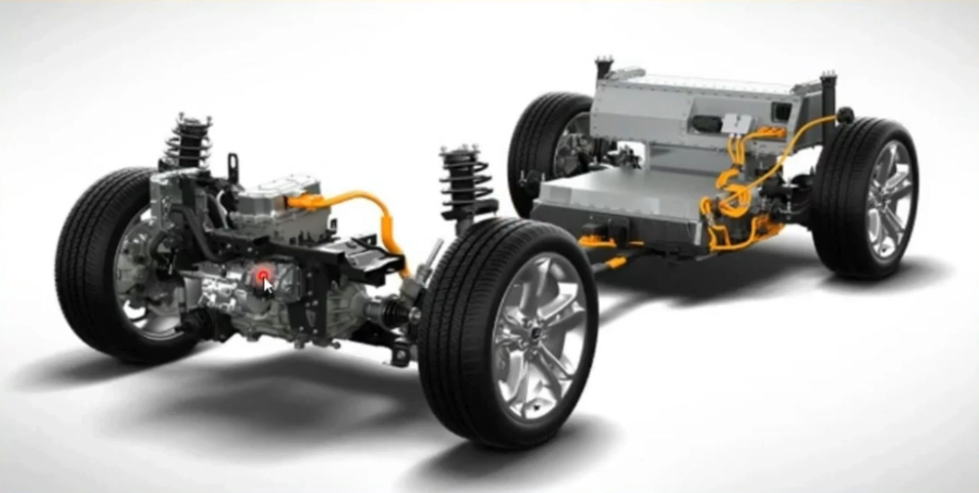
Ford Focus Electric vehicle

Slide 7
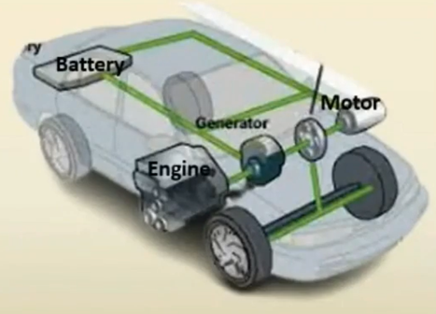
Hybrid electric vehicle (HEV)
• HV is a combination of two different vehicle systems incorporated into one vehicle:
IC engine
Electric motor powered by batteries
• Based on the method of charging, HVs can be
categorized as:
Hybrid
Plug-in Hybrid
• The battery of HV is charged by regenerative
braking and also by IC engine. Electric power
is suitable for small range
• Plug-in HV can also be plugged-in for charging
and provide relatively higher range.

Slide 8
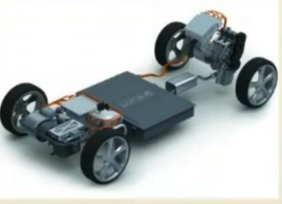
Series hybrid electric vehicle
Developed by adding a small IC engine/generator to the BEV.
Usually used in heavy vehicles: heavy commercial vehicles, buses and even locomotives.
Advantage
Single torque source (electric motor) to the driven wheels simple speed
control.
Nearly ideal torque-speed characteristic —i multigear transmission
unnecessary.
Simple structure and control of the traction system.
Mechanical decoupling between the IC engine and the driven wheels
Disadvantage
Twice the energy form conversions (mechanical/electrical/mechanical).
Two electric machines are needed (electric generator and traction motor).
Big traction motor since it is the only torque source of the driven wheels.
Lotus PROTON Series HEV

Slide 9
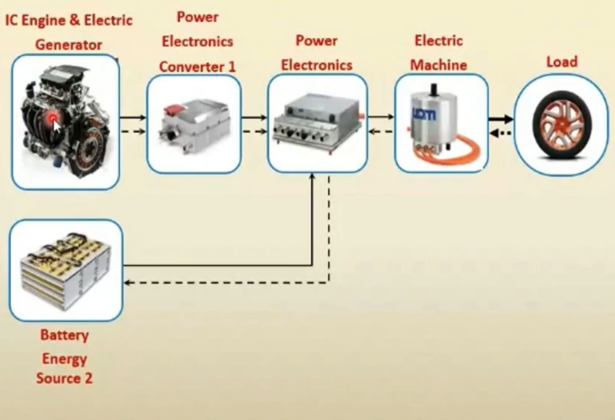
Energy Flow of Series HEV Traction System
IC Engine alone delivers power to load;
Battery alone delivers power to the load;
Both IC Engine and Battery deliver power to load at the same time;
Battery obtains power from load (regenerative braking);
Battery obtains power from IC Engine ;
Battery obtains power from IC Engine and load at the same time;
IC Engine delivers power to battery, and battery delivers power to load;
IC Engine delivers power to load and to battery at the same time;
IC Engine delivers power to load, and load delivers power to battery.

Slide 10
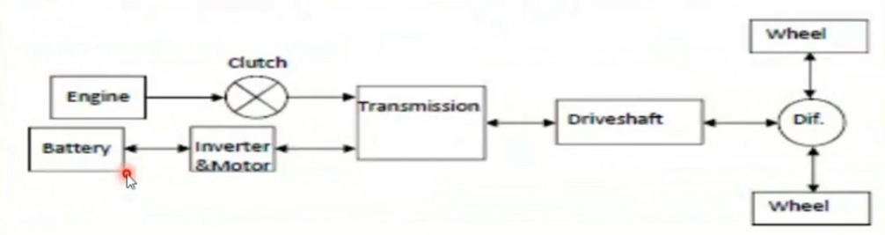
Parallel hybrid electric vehicle
• A parallel hybrid is an HEV in which more than one energy converter
can provide propulsion power
• Uses one machine for motor and one for generator functions
• Motor sized for a fraction of peak vehicle power
• Power flows from engine directly through transmission to drive wheels

Slide 11
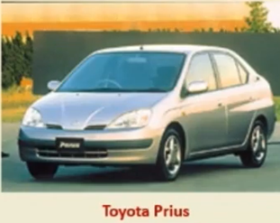
Both the ICE and the electric motor are connected to the driveshaft
Two power paths
Hybrid power unit or electric propulsion system or both can power the wheels
For long trips the engine is used
For hills, acceleration, and high power scenarios the electric motor is used
Advantages
Smaller engine or motor can produce the same performance
Disadvantages
Control complexity
Power blending from the ICE and motor necessitates a complex mechanical device

Slide 12
Comparison
Propulsion Comparison | Series Configuration | Parallel Configuration
Benefits | Engine never idles reducing emissions Engine drives a generator to run at optimal performance Allows a variety of options in mounting the engine Some don't need a transmission | Has more power from simultaneous power from motor and engine Don't need a separate generator because the motor generates the battery Power is directly coupled to the road so can be more efficient

Slide 13
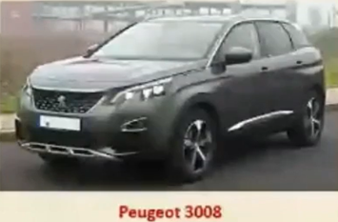
Series – parallel combination HEV
• Uses two Machines: generator and motor
• Motor and generator are sized for fraction of peak vehicle
power
• Provides both series and parallel path from engine to drive
wheels
• A small series element + parallel HEV (Ex: Toyota Prius)
• IC engine is also used to charge the battery
• Electric motor delivers power to the front wheel in parallel
with the ICE
• Inverter is bi-directional: Charging batteries and providing
power to motor
• Central control unit regulates the power flow

Slide 14
HEV Advantages
Regenerative Braking
Reduction in engine and vehicle weight
Fuel efficiency is increased
Emissions are decreased
Cut emissions of global warming pollutants by 1/3 or 1/2
Reduce the dependency on fossil fuels
Some states offer incentives with owning an HEV
N 2 times more efficient than conventional engines

Slide 15
HEV Challenges
• Energy storage devices with high power-to-energy ratios
• Frequent shut down and start up of the HEV
• Reduce the size, weight, and cost
• Higher efficiency in the conversion of fuel to useful power
• Advanced configurations for the propulsion system components

Slide 16
Thank you

